Slide 1
QEP Secondary Math Options Explained… sort of
Franca Redivo
Secondary Math Consultant
Lester B Pearson School Board
February 2010

Slide 2
The Math Content:
Old Math Program:
Content driven
Cultural, Social and Technical Option
100 hours
Science Option
150 hours
416-514
426-526
436-536
Technical and Scientific Option
150 hours
New Math Program:
Approach driven
Notes:
In the old programs, a small portion of the content was common to the three sequences (as represented by the intersection of the three ellipses appearing on the left side of the slide). The intermediate 426-526 sequence was altogether a subset of the advanced 436-536 sequence. You can see the hard, medium and regular math structure.
Although the three math options associated with the QEP have common content, none of the options is a subset of another. No option is particularly easier than another and each option is meant to take 2 years. You will note that one option has 2/3 the number of hours. If your child does not like math, he or she would probably be happier in an option that has less math in it, hence the CST choice.
Given the structure of these three options, it is not recommended that students switch options between secondary 4 and 5 – especially between the TS and Science options. While the content is similar, it is presented differently over the two years. A student will find some material is repetition and material which they will be expected to know, will be unfamiliar. The only exception to this would be a student going from TS-4 to CST-5 because of a much closer alignment of content in Secondary 4. It is also possible for a student who has done well in CST-4 to make up missing content (via a summer school bridge course) and switch to TS-5. If a student has chosen the Science option, it is strongly recommended they stay there for the two years.

Slide 3
Math Options: Aims
Cultural, Social & Technical (CST) | Technical & Scientific (TS) | Science (SN)
Prepares students for studies in the humanities, social sciences, communication and the arts (and life!) | Prepares students to work effectively in technical fields related to business, nutrition, biology, physics, fine and graphic arts | Prepares students for the pursuit of the hard sciences and research by emphasizing abstract thinking
Notes:
This is taken from the QEP documentation and suggests the fields of study in CEGEP that each option can lead to, not what kinds of jobs a student could aspire to. Let me illustrate by showing you the focus of each option (next slide)

Slide 4
Math Options: Focus
Cultural, Social & Technical (CST) | Technical & Scientific (TS) | Science (SN)
Consolidate Integrate Interpret Apply | Compare Analyze Judge Explore | Abstract Prove Model Theorize
Notes:
These are descriptors for what the students do in the options. On the following slides there are examples that illustrate how these would translate into jobs/careers in Food, Art and Business. By giving these examples, I am also trying to give you a feel for the types of students who should be going into these options.

Slide 5
Food
CS&T: food critic, food stylist: they have to understand food, know what quality food is like, know what types of food go well together, understand the ingredients but they bring something extra to the table in that also understand what people who eat food like.
T&S: host of a cooking show, cookbook author: they will experiment with different recipes, substitute ingredients until they find the perfect combination, they will determine the best process for creating recipes and make adjustments as they feel are necessary
Science: working in test kitchens for Chatelaine or Kraft, figuring out ways to preserve food, study the effects of various food additives, devise menus that will meet the nutritional requirements of, say, the Army

Slide 6
Art
CS&T: Art historian, gallery owner – they understand art, they can tell the difference between good and bad art, they have developed an “eye” for quality and perhaps an understanding of what potential clients want and can find art that pleases them
T&S: The artist – they practice, develop techniques and alter them as they see the effects of what they try, they try different materials, they look around for inspiration and try new things – maybe it works for them, maybe not
Science: “supplier of materials” – they develop the paints used by artists, they come up with ways to improve the longevity of the paint (and other materials), they develop ways to make artists’ materials more environmentally friendly, they come up with new ways to authenticate old works of art or detect forgeries, they could come up with regression analysis to try to predict the value of certain works of art.

Slide 7
Business
CS&T: gather and analyze data, be able to read reports and get a story from them, understand the implications of these stories and act on suggestions
T&S: create a business plan, design new reports in order to get new information, figure out what information would be needed in order to improve services, sales, environmental impact, see trends and patterns
Science: determine which data to analyze and how (data-mining), operations research (optimization), creating mathematical models for the purpose of projecting (predicting)
Notes:
Please remember that TS and Science Math open all the same doors at CEGEP.

Slide 8
That being said, and practically speaking,
The students who don’t really like math and don’t think they are good at it, should be encouraged to go into CS&T – because that course has less math in it.
The students who love math, do their homework, love the intellectual challenge of it, would enter math contests if they were offered – these are the students who would enjoy the Science math.
TS math is for the very capable math student who sees math as a tool and wants to know how it works and how to use it.
Please remember that TS and Science math open all the same doors at CEGEP

Slide 9
TS vs SN
Given that TS and Science math are treated the same at CEGEP, why are they both offered.
The authors of the QEP knew that people learn differently but can learn the same things so the two courses were designed to approach similar content in different ways.
The following 4 slides will try to illustrate a bit the difference. I hope you will agree that the models are both quite capable in their own ways…

Slide 10
Students: Technical & Scientific
Students who choose T&S like using their
Manual skills
Building and using instruments
Constructing models
Intellectual skills
Determining how instruments work
Suggesting changes and improvements
Designing tools, instruments, buildings, etc.
Analyzing economic and financial scenarios

Slide 11
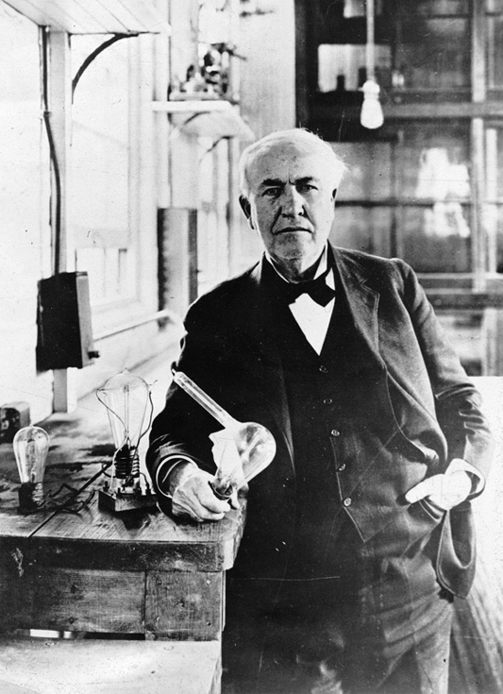
Thomas Edison
Inventions
Cylinder Phonograph
Disc Phonograph
Electricity & the lightbulb
Kinetophone
Kinetoscope
Film Projectors
Motion Pictures
1,093 Patents
I have not failed. I've just found 10,000 ways that won't work. Thomas A. Edison
Notes:
My model TS student:
I have not failed. I've just found 10,000 ways that won't work. Thomas A. Edison

Slide 12
Students: Science
Students who choose SN
Want to understand phenomena:
Their origins
How they work
Make decisions about them
Focus on
Finding and developing models within the context of experiments
Formal proofs to confirm truths
Properties of math objects in the abstract

Slide 13
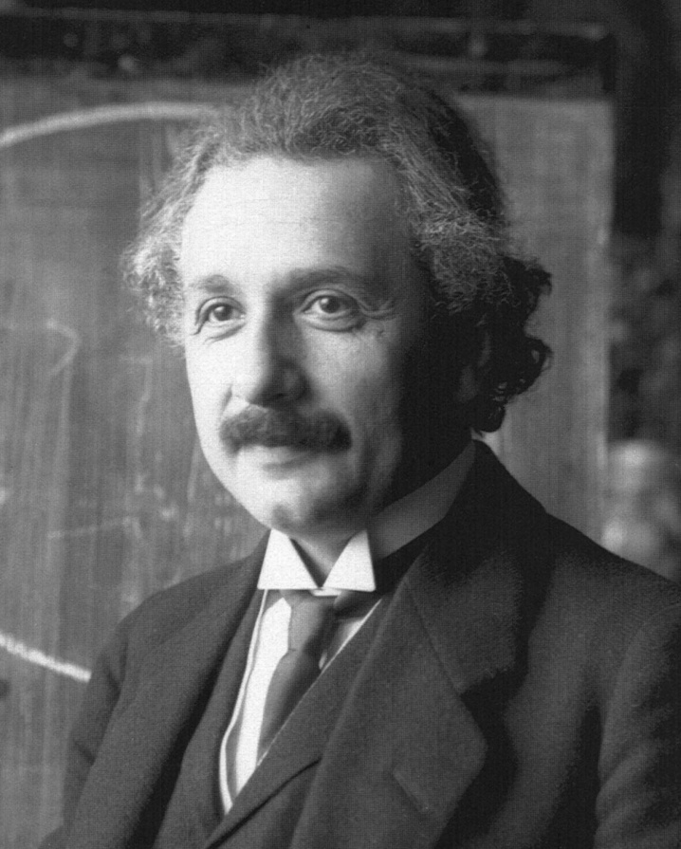
Albert Einstein
theories of special relativity and general relativity
contributions to statistical mechanics - Brownian motion
resolution of the paradox of specific heats
connection of fluctuations and dissipation.
contributions to quantum mechanics and quantum field theory
theoretical studies of the photon
The whole of science is nothing more than a refinement of everyday thinking.
Albert Einstein
Notes:
My model SN student:
The whole of science is nothing more than a refinement of everyday thinking.
-Albert Einstein
"One had to cram all this stuff into one's mind for the examinations, whether one liked it or not. This coercion had such a deterring effect on me that, after I had passed the final examination, I found the consideration of any scientific problems distasteful to me for an entire year." (This is what the QEP is trying to address)
"Imagination is more important than knowledge." (Because imagination is what allows you to use knowledge.)
“Anyone who has never made a mistake has never tried anything new.“ (Take this to heart yourselves!)

Slide 14
Challenges
Narrowing the gap between where we are and where we want to be
Adapting current resources to activity based learning
Changing the current thinking on how to evaluate
Changing the current thinking on what to evaluate.
Still ensuring the concepts & processes are learned without emphasizing them in evaluation
Not overwhelming the teachers!
Helping parents to understand what is going on with their child’s math education.
Notes:
We will be billing these math courses as one thing but our teachers will not all be equally comfortable in offering the courses as advertised. The variation between classes of the same course might be great whereas the variation between options might be very small.
Since the content is very similar, it will be hard for teachers to come up with other ways of teaching the content they have been teaching for years. The real challenge is that most teachers really can’t answer the question “when will we ever use this?” The CS&T teachers will have the easiest time of it, the Science teachers will be able to get away with old-style teaching since the theory and rigour is similar to what we should have been expecting from our *36 students, but it will be the T&S teachers that will have the biggest challenge relating the math they will be teaching to situations.
Teachers are accustomed to marking tests and quizzes and looking for right and wrong answers. They will have to start using other means to assess students’ progress including informal (and formal) interviews, observations of students’ work in class, oral presentations, group work… math class just can’t look the same as it used to…
Teachers will (continue to) lament the lack of focus on skills since that is no longer what will be evaluated directly (yet they are still responsible for ensuring the students develop these skills and processes.)
We need to inform parents about what is going on and that all the best research supports this approach to learning and teaching math.

Slide 15
Thank you…
… for taking the time to go through this presentation.

